Slide 1
Self-diagnosis of UAVs:
Our team consists of:
Shustov Stanislav
Sergeev Stanislav
Bisarov Aleksey

Slide 2
Main task
Our goal is to create a neural network that could receive logs from UAVs, analyze them, and output data on events that occurred from UAVs during the flight in a more understandable form for humans

Slide 3
List of diagnosed events
Collision damage
Falling
Damage to the blades
Exiting the flight zone
Signal outages
Battery malfunction
Drone hijacking

Slide 4
The structure of the neural network
When creating a neural network, the Python programming language was used, in particular the Tensorflow and Keras libraries. Libraries contain different types of layers for implementing various structures of non-linear networks (Denese, Conv2D, etc.). To solve this problem, we need to use recursive layers that are better suited for processing a sequence of information than the same fully connected layers.

Slide 5
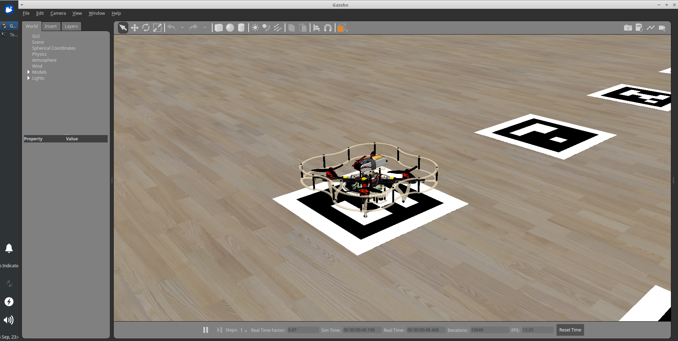
Dataset
We collect the dataset using the Gazebo simulator in which you can simulate various situations and scenarios.

